Slide 1
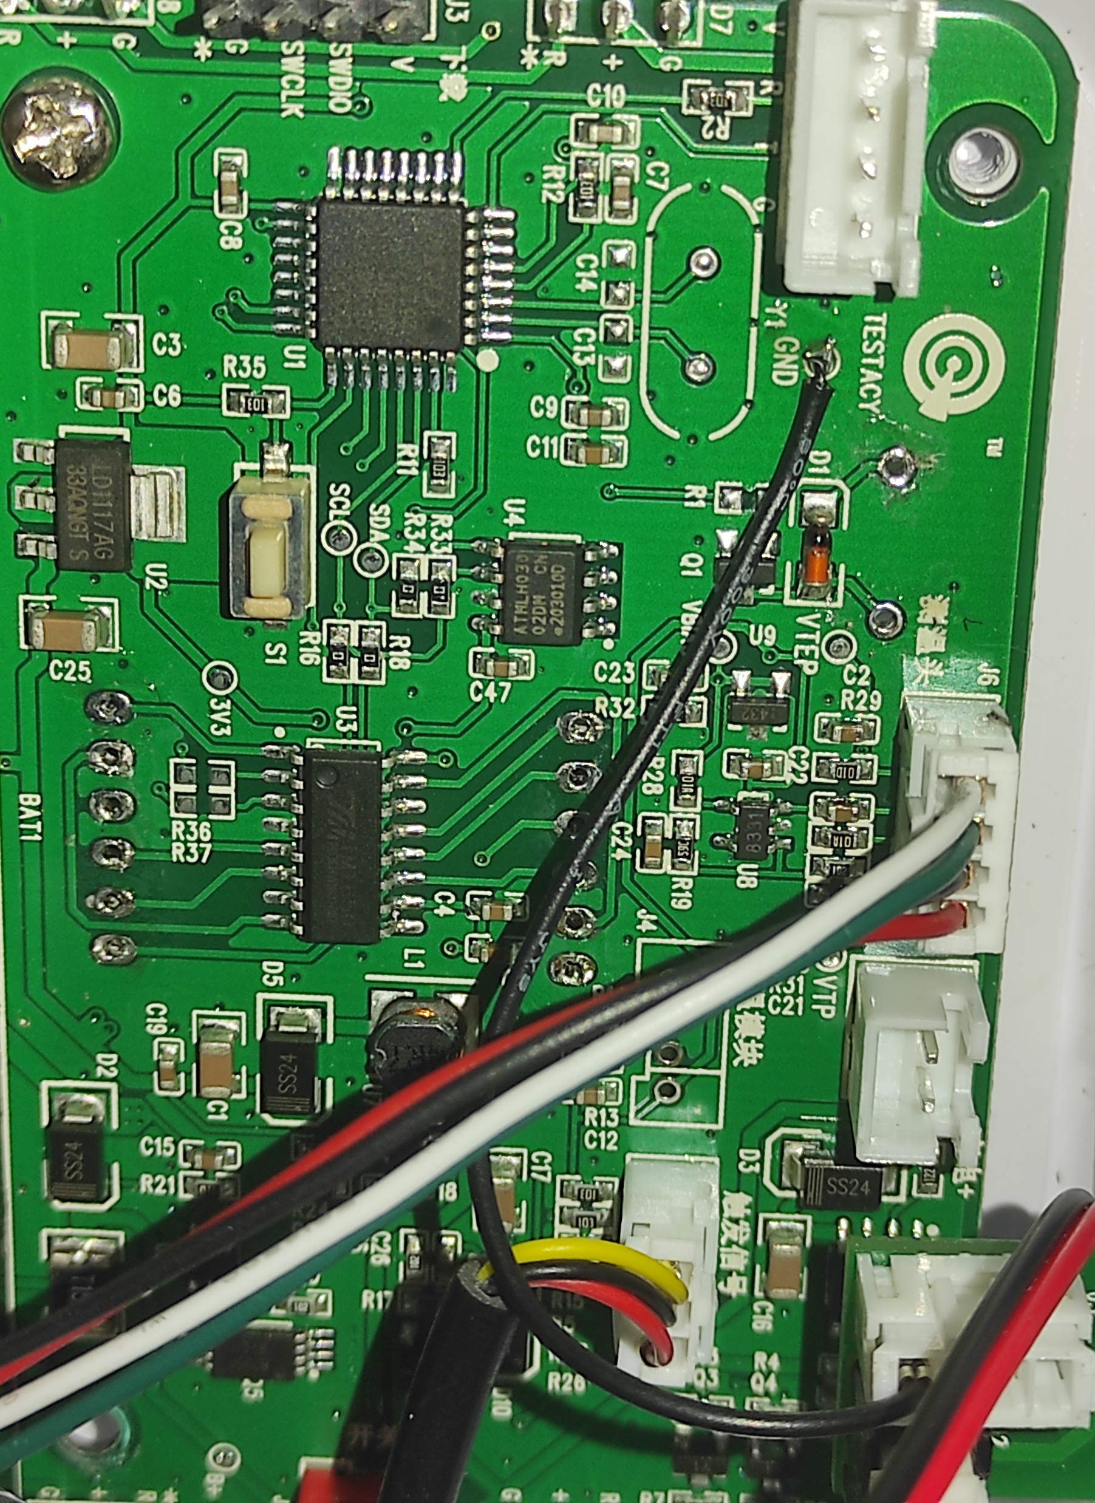
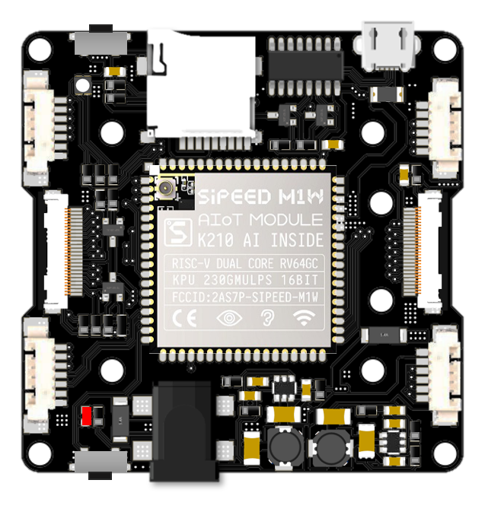
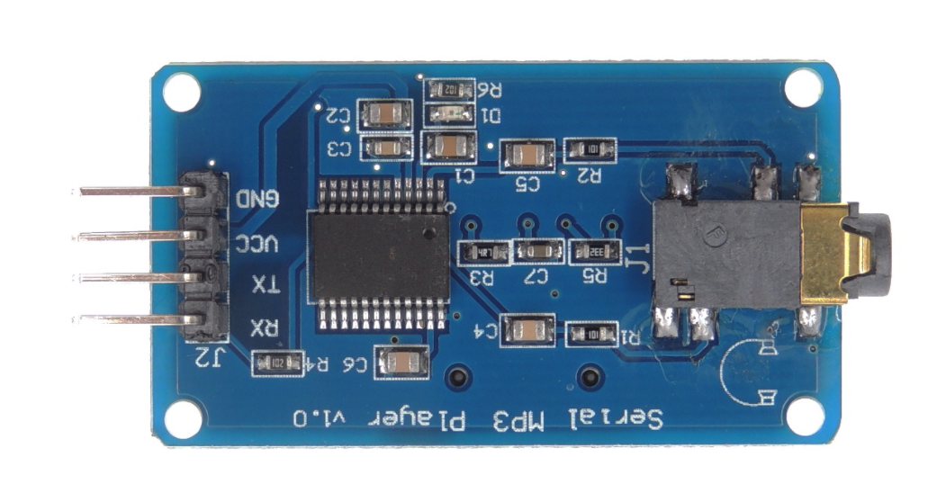
0
1
2
3
10 3v3
GND
INPUT2
GND 3v3
18
19
20
21
OUTPUT1
MP3 UART Module
(YX-5300)

Slide 2
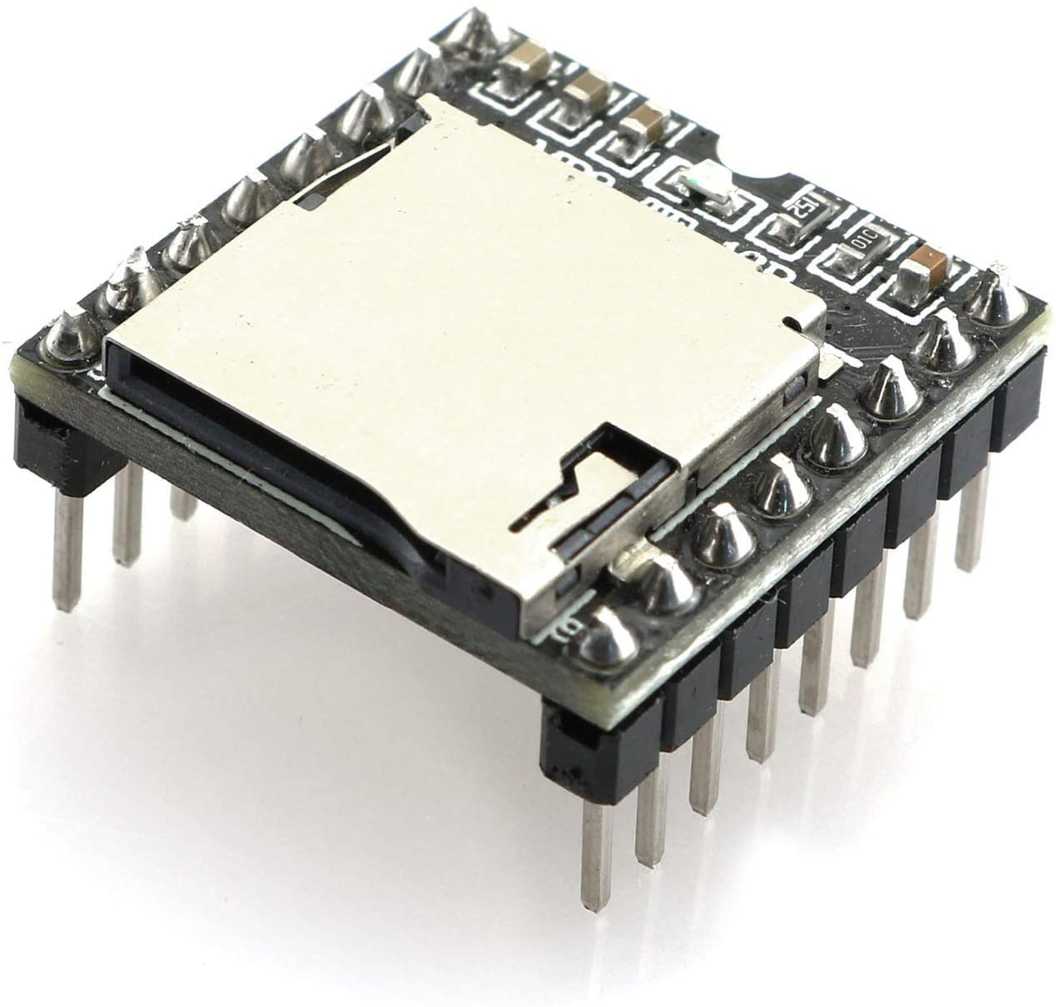
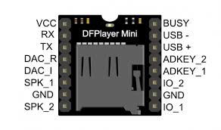
MP3 UART Module
0
1
2
3
10 3v3
GND
INPUT2
GND 3v3
18
19
20
21
OUTPUT1

